Slide 1
ADU energy simulation and analysis: an evolutionary approach
Preston Pape

Slide 2

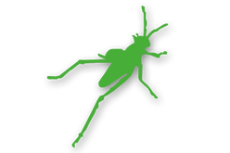




WWR, all orientations (0% <= x <= 95%)

Slide 3
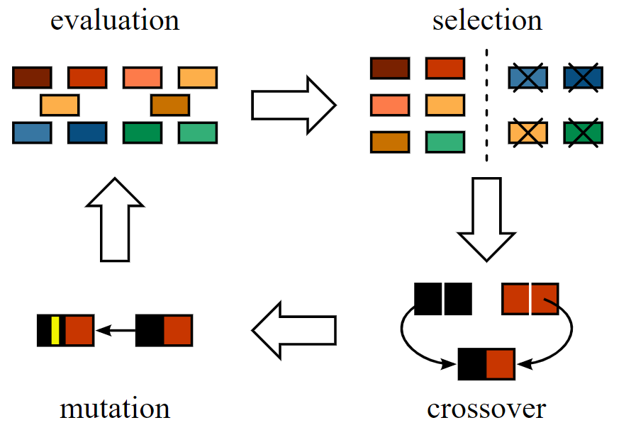
http://www.jade-cheng.com/au/coalhmm/optimization/
Notes:
Genetic algorithms

Slide 4
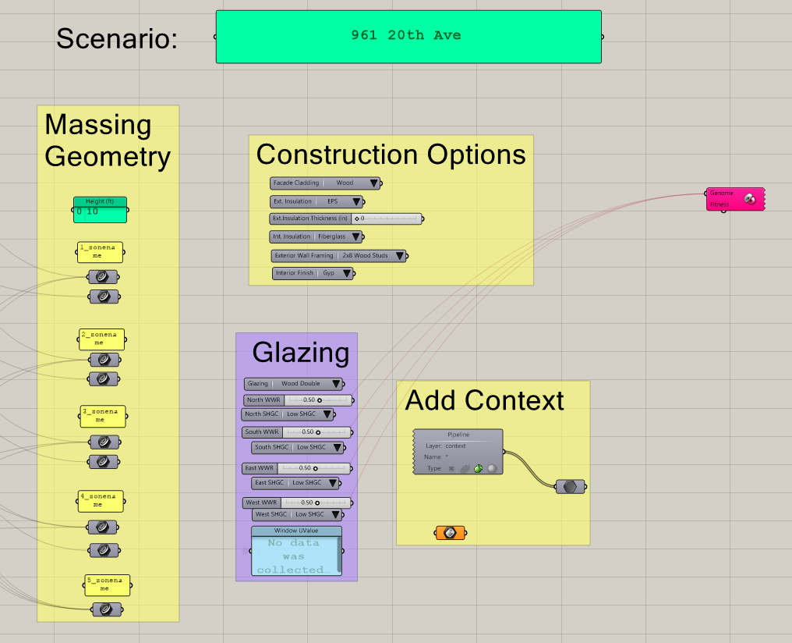
Grasshopper Tool UI
Notes:
Grasshopper

Slide 5
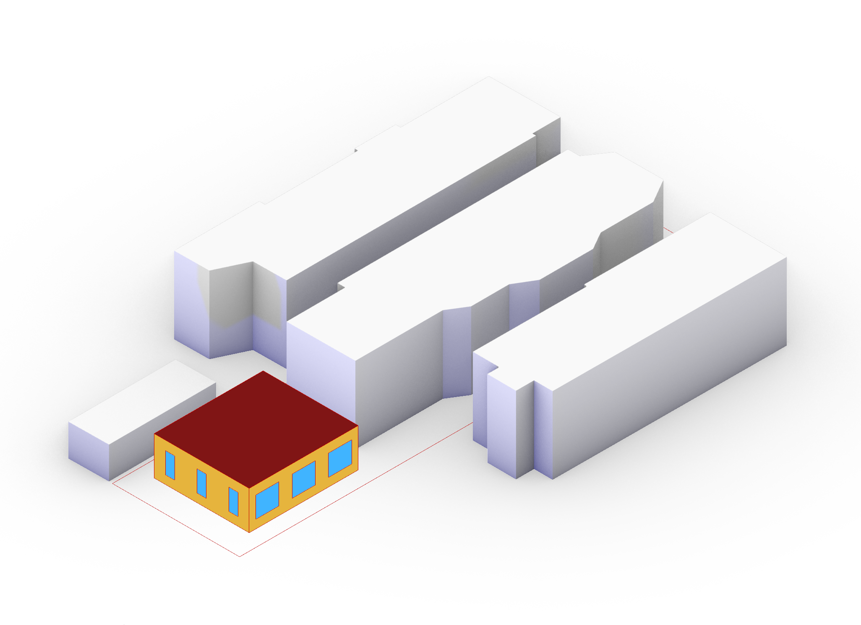

Slide 6
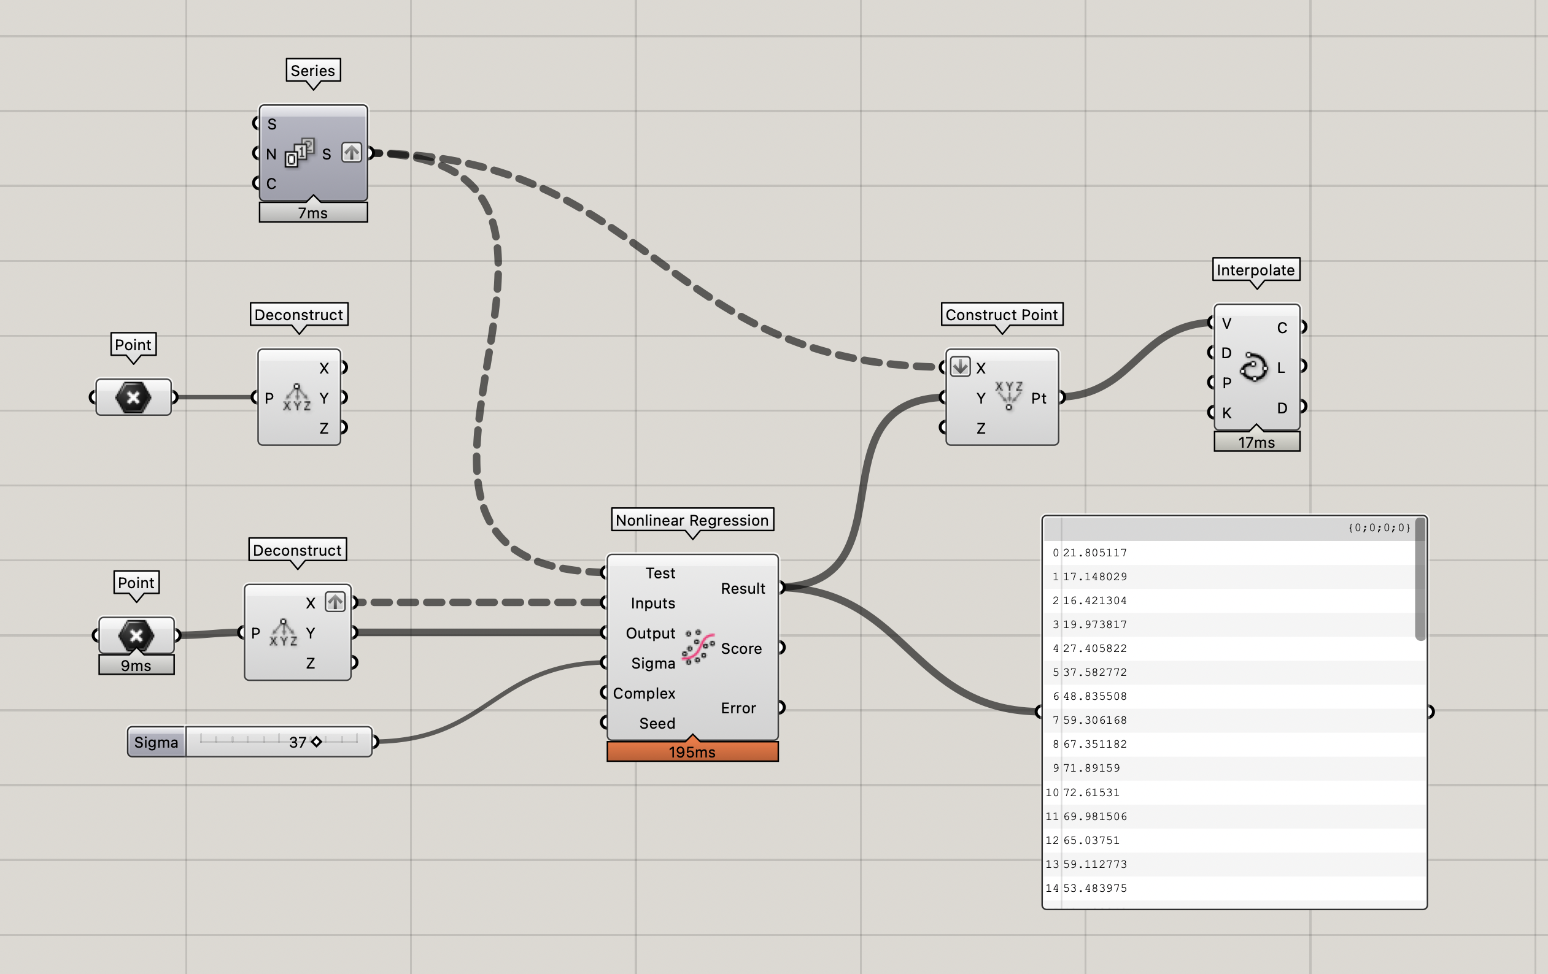
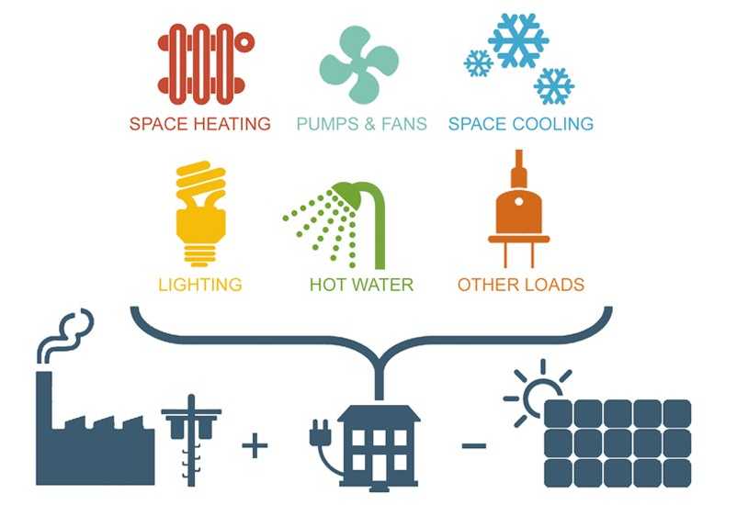
https://www.buildingenclosureonline.com/blogs/14-the-be-blog/post/87007-energy-use-intensity-eui-in-simple-terms
Notes:
Conclusion

Slide 7
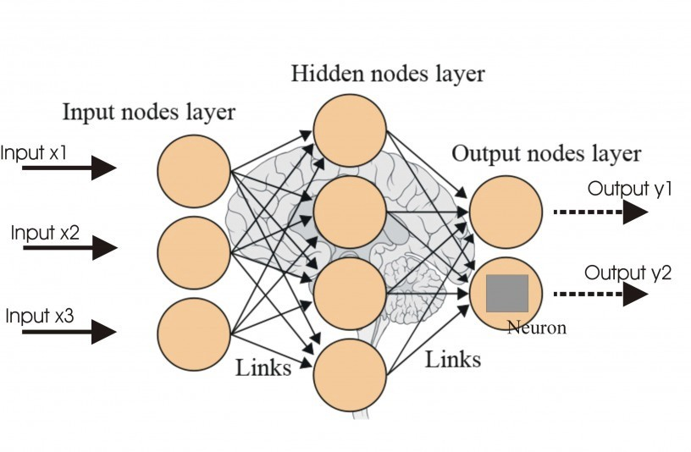
https://blog.goodaudience.com/artificial-neural-networks-and-its-contribution-to-machine-learning-a-beginner-s-hand-book-ab7f4e7b230e
Notes:
Future work

